Slide 1
Characteristics
of the Socially Engaged Research in Life Sciences
Diana Surová
CZU Prague

Slide 2
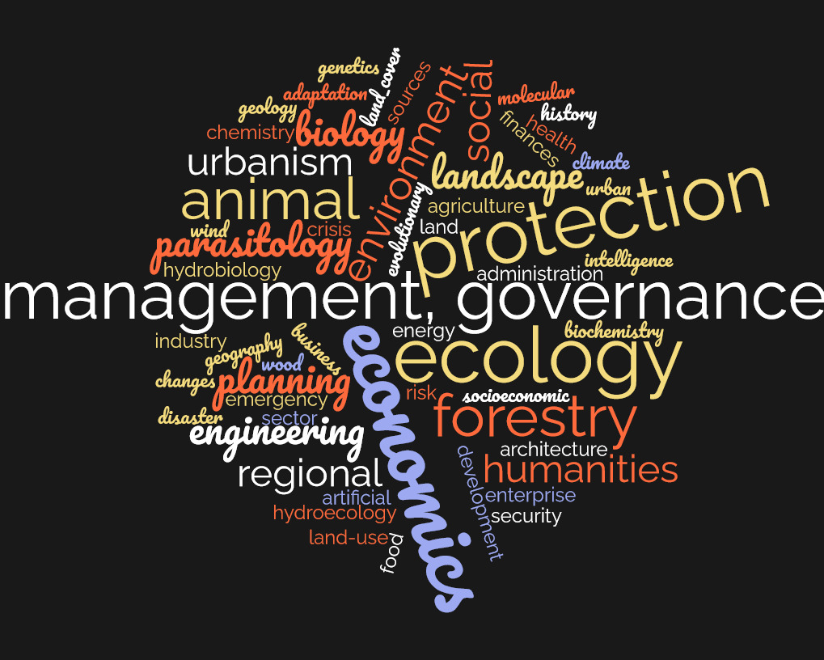
Participants’ study fields – Summer school 2024

Slide 3
Mentimeter Survey
https://www.mentimeter.com/
6386 6373

Slide 4
Socially engaged research why do we need it?
Global challenges and the real-life problems cross discipline boundaries –
to be addressed properly - need collaborative and trans-disciplinary research
More complex settings - multiple disciplines + different stakeholders (symbiotic or conflicting opinions, values, priorities) + public
to be applied properly
motivating – makes research more meaningful, valuable, relevant and more impactful
new approaches needed
to bring people together from different backgrounds and work together
new capabilities and skills
(from researchers and society)
up-to-date - no “universal” framework or guidelines for SER
- relevant for different research disciplines, „platform“ where different research disciplines meet and can contribute to development of the SER topic (conceptualization, trainings, approaches and tools development, etc.)
​

Slide 5
SER and other terms with similar meanings
POLICY and GOVERNANCE actions
activities to incorporate people’s interests, concerns, needs, and values
focus on -
decisions and actions on public issues
RESEARCH
social sciences and humanities perspectives
collaborations among scientists and stakeholders
address real problems
Public engagement (participation)
Citizen -participation /engagement/
involvement/ empowerment
Transdisciplinary approaches / research
Interactive approaches / research
Community engagement / research
Participatory approaches / research
Community-based approaches / research

Slide 6
SER and other terms with similar meanings
 | N of publications | Most frequent subject area | 2nd most frequent subject area | 3rd most frequent subject area
Community research, Community-engaged approach | 70304 | Medicine | Social sciences | Environ. sc.
Interactive approach/ research | 33443 | Bioch, Gen, MB | Engineering | Medicine
Citizen engagement / involvement | 17479 | Social sciences | Environ. sc. | Medicine
Participatory approach/ research | 10912 | Social sciences | Environ. sc. | Agricult. and biol. sc.
Transdisciplinary research / apr./ TD | 2717 | Environ. sc. | Social sciences | Agricult. and biol. sc.
Public engagement/ particip. | 2537 | Social sciences | Medicine | Environ. sc.
Publications on ScienceDirect until 2024

Slide 7
Transdisciplinarity

Slide 8
Varieties of transdisciplinarity
 |  | Collaboration (level of stakeholders’ participation)
Integration (concepts, methods from diff. disciplines) |  | narrower | broader
Integration | shallower | Soft transdisciplinarity | Inclusive transdisciplinarity
 | deeper | Reflexive transdisciplinarity | Hard transdisciplinarity
Balsiger 2015
weak vs strong
consulting vs participatory
TD varieties may change across research stages

Slide 9
How not to get lost - Levels of transdisciplinary research
Hirsch Hadorn, Gertrude & Bradley, David & Pohl, Christian & Rist, Stephan & Wiesmann, Urs, 2006. "Implications of transdisciplinarity for sustainability research," Ecological Economics, Elsevier, vol. 60(1), pages 119-128

Slide 10
Society Engagement in various research project phases
Idea
/vision
Proposal
Initial stage
Middle stage
Final
Post project
Before
Network building
Design preparations
Focus groups
During
Knowledge co-creation; Interviews
Questionnaires
Focus groups
Workshops, etc.
Citizen science
After
Social media, Websites,
Databases
Presentations, Publications
Exhibitions, Trainings, lifelong learning activities etc.
DISSEMINATION
SCIENCE POPULARIZATION

Slide 11
Principles of transdisciplinary research quality

Slide 12
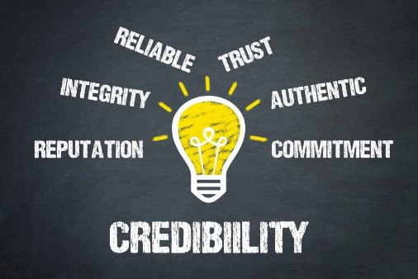
Principles of transdisciplinary research quality
Relevance
Credibility
Legitimacy
Effectiveness
Brian M. Belcher, Katherine E. Rasmussen, Matthew R. Kemshaw, Deborah A. Zornes, Defining and assessing research quality in a transdisciplinary context, Research Evaluation, Volume 25, Issue 1, January 2016, Pages 1–17, https://doi.org/10.1093/reseval/rvv025

Slide 13
1. Principle of transdisciplinary research quality - RELEVANCE
Based on Belcher et al. 2016
Importance
Social significance
Usefulness (Applicability)
timing
useful outputs
research questions
scale
Objectives, processes and findings
Notes:
.

Slide 14
2. Principle of transdisciplinary research quality - CREDIBILITY
Based on Belcher et al. 2016
Robust research findings
well-presented methods
Knowledge – scientifically trustworthy
logical interpretation of findings
new
ongoing learning
Active reflexivity
adaptation (e.g. language)
flexibility (e.g. time, learning new things)
Technical aspects of the research

Slide 15
3. Principle of transdisciplinary research quality - LEGITIMACY
Based on Belcher et al. 2016
new
perceived as fair and ethical process –
from the end-users' perspective
inclusion
diverse values
interests
? do they trust researchers
? do they feel represented
collaboration and mutual learning are crucial
Socio-political aspects of knowledge production

Slide 16
4. Principle of transdisciplinary research quality - EFFECTIVENESS
Based on Belcher et al. 2016
Contribution to positive change in the social, economic, and/or environmental problem context
research objectives
research process
reflection on the usefulness
new knowledge
learning from each other
research product for practical use
changes in behaviors or practices

Slide 17
Who to involve in SER?
applied to European Union-sponsored projects and policies
Active involvement of quadruple helix framework
Public
Communities of interest
Researchers
Academic and non-academic researchers
Policy makers
Local authorities
Industry practitioners
Business and industry
NGOs
Community organizations
govern. – regional, national, local
the media
All target groups should be sufficiently represented

Slide 18
Stakeholders – non-academic actors
persons (individuals who influence public - "opinion-makers“
having an important role in the topic of given project and bringing their experience
representing the interests of a larger group of people, not just themselves as individuals
organizations (civic associations and interest groups, company, institution or associations
for a successful participatory process, it is essential to be able to identify the key actors who need to be involved in the project, and at the same time to choose the right way for their involvement
Stakeholder mapping procedure:
Explore the context of the problem addressed and community (consider goals of the projects)
Explore available sources (websites, social networks, newspapers, documentation, etc.) to learn more about key actors
Ask locals, colleagues and experts about other key actors (e.g. through a brainstorming workshop, questionnaire, interview)
Snowball procedure – key actors can suggest other relevant actors and stakeholders
Create stakeholders’ database: Name, Organization, Contact information, Role (position) relevant to the project, Opinion on the given topic Previous involvement in a given / similar topic or project

Slide 19
What is co-creation (or co-production) of knowledge between science and society?
a set of interactive and colaborative processess involving diverse types of expertise, knowledge and actors to produce context-specific knowledge and pathways towards a sustainable future (Norström et al. 2020)
science about sustainable development
importance:
- human relationships between people that make co-creation work
- time investment into making those relationships function, understanding people and creating mutual trust

Slide 20
Participatory methods
Participation: processes in which individuals take part in project or decision-making that affects them; it is an active choice to get involved to shape the future. Examples:
Interviews- in-depth about experiences, opinions and comments; suitable for getting more details (e.g. causes, connections, etc.); can contribute to trust building
Focus groups - moderated group discussion with participants from the target group, participants are randomly selected to ensure representativeness within the population. Suitable for getting ideas on a given topic
Questionnaires – to explore opinion, preferences or validate hypotheses among a larger number of members of the target group
Voting or voting questionnaires - for prioritization, understanding what is important for the stakeholders
Workshops - a meeting (personal or online) at which a group of people engage in intensive discussion and activity on a particular subject of the project
When choosing only one or few methods in SER- those that allow for two-way communication are better. A personal meeting cannot be completely replaced by a questionnaire survey
Interaction between different people can stimulate the emergence of new ideas, build relationships, improve communication and strengthen the whole community.

Slide 21
How to motivate people to participate
Participatory methods require investments (e.g. time, money, efforts)
from both participants and organizers
make participation useful for potential participants - examine people’s motivation
they may want to have a say in local (regional) planning, or some issue,
in policy recommendations or can also be driven by social reasons:
to meet other people, to network, to learn new things
ensure trust - the degree to which people trust a certain project and its organizers influence
whether they want to spend time and effort on the project
adapt settings of the meeting
location - people prefer activities that are organized in their own living environment (safe space and less travel time), a way for organizers to show their willingness to truly engage
duration of an activity – adapted to project goals, the duration has implications for people’s willingness to participate, longer workshops (of halve a day or even a whole day or multiple days) generate more results for a project or for policy development yet long activities automatically attract fewer participants

Slide 22
Facilitation of participatory meetings
Facilitation - Carrying out a process of group meeting and discussion so that specific outputs, data and information are obtained in the end
FACILITATOR
- creates a welcoming environment
- ensures equal involvement of participants
- topic and time limit
- takes a neutral position
- some facilitating methods: icebreaker (short, fun, simple),
brainstorming, voting, etc.
MODERATOR - similar to facilitation but brings his views into the discussion
RECORDER – takes notes and collect data from the meeting and/or audiovisual recording
Attendance list for collecting contacts and confirming that participants agree to audiovisual recording and data processing according to the GDPR.

Slide 23
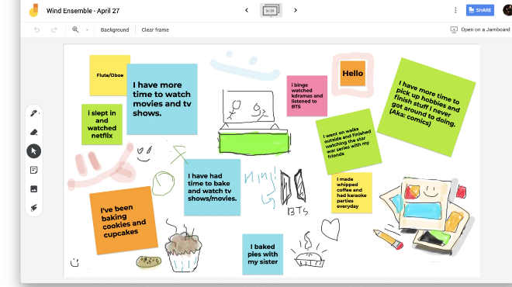
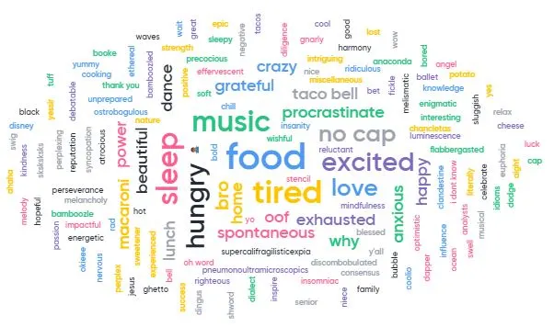
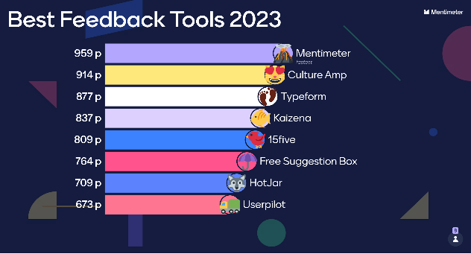
Participatory methods – Online meeting tools
Online meeting tools - Real-time collaboration
Googlemeet, Microsoft Teams: Collaboration in the Microsoft Ecosystem – video conferencing and screen sharing
Mentimeter - tool for meeting engagement - Real-time feedback and surveys
Miro, Jamboard – Google digital whiteboards - collaboration in real time
Zoom / time restrictions / Breakout rooms for group discussions
….others

Slide 24
THANK YOU
Diana Surová (surova@pef.czu.cz)

Slide 25
Previous responses - online Spring School 2024

Slide 26
Insights about what we learned during the 1st day of the Spring School
science communication
- is important

Slide 27
Transdisciplinarity – 7 principles
Transdisciplinary research is best applied to complex problems.
Transdisciplinary research is place-based.
Transdisciplinary research is time intensive.
The term 'transdisciplinary' relates more to academia than to research partners (sometimes called stakeholders).
Transdisciplinary research requires well-developed leadership skills.
Transdisciplinary research is intensely collaborative.
Transdisciplinary research merges multiple knowledge streams and different value systems to create new knowledge.
(Dennison 2017 - Transdisciplinary literacy: Seven principles that help define transdisciplinary research)

Slide 28
Participatory methods – group meetings
Participatory PLAN - formulate analysis questions, discussion topics, workshop (s) assignments
prepare meeting structure – opening, icebreaker, activity1 (introduction, debrief), break, activity 2, closing section (reflection; feedback and closing)
All target groups should be sufficiently represented
Communication:
motivation for participation - different groups - in different ways
clearly explain the purpose of participation and its possible limits (to avoid unfulfilled expectations)
use contextuality relevant language
Output processing:
- attendance list - contacts – for outcomes communication or for future similar meetings
– a short questionnaire at the end of the meeting to get feedback
- prepare outcomes for:
a] scientists
b] community

Slide 29
What are your expectations from the Spring School about Socially Engaged Research (SER) (51responses)
… something new
understand the topic – what it is; understand different concepts
networking
inspiration
exchange of ideas
latest trends, challenges and opportunities
practical skills – strategies, techniques
watch some examples
how to apply it
to your ongoing research
new knowledge and skills
how to involve people to work together
… not sure
new ideas for research
how to create new connections
new perspectives and innovative ways of research dissemination
how to communicate with local community and with governmental institutions
… I am new to this, so I do not know what to expect
how to create a research bringing positive contribution to society
first steps in a new world

