Slide 1



The problems and challenges of socially oriented research in the field of life sciences
Funded by the European Union. Views and opinions expressed are however those of the author(s) only and do not necessarily reflect those of the European Union or European Research Executive Agency (REA). Neither the European Union nor the granting authority can be held responsible for them.
Ecosystem Services, Tourism, Community Engagement, and Conservation Strategies in National Park, BetterLife summer school, Prague September 9-14, 2024
Anton Shkaruba
anton.shkaruba@emu.ee
September 9, 2024

Slide 2
It is me:
BSc (specialist degree) in geography, min. terrestrial hydrology
MSc in international environmental sciences
PhD in geographical ecology
Worked for the Research Institute for Water Resources in Minsk, Central European University in Budapest, environmental consultancy Erda RTE in Rotterdam etc.
Senior researcher at EMU since 2018, Chair of Environmental and Landscape Management
  Current projects – Horizon BetterLife, LAND Europe; Jean Monnet TRIGGER, Erasmus+CBHE URGENT, DOMANI, Erasmus+ CA SUNRAISE
Key words – green planning, biodiversity and land-use governance, engaging science, nature-bases solutions, ecosystem services / disservices

Slide 3
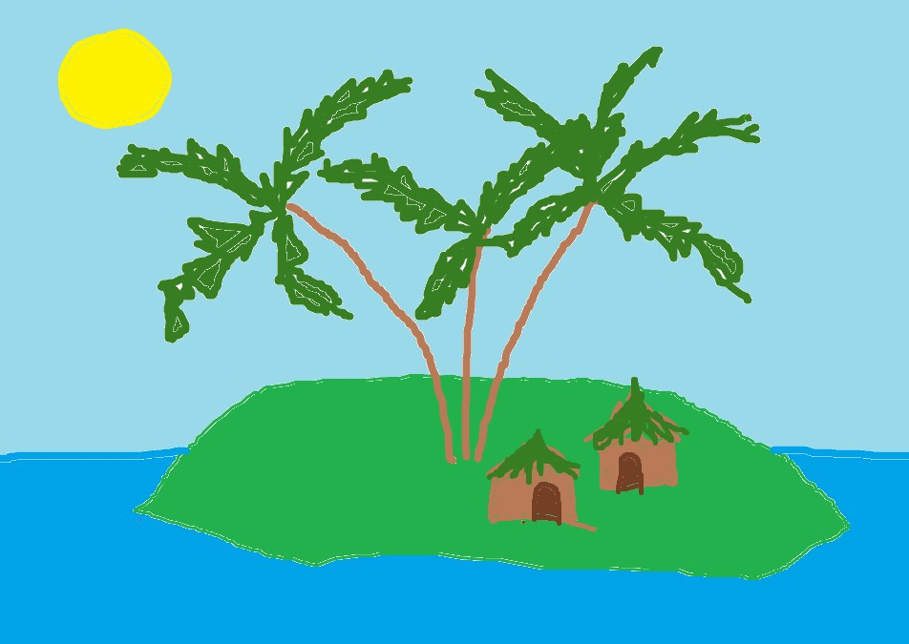
Us and the Nature
We are a part of the nature and need to exploit it to attain desired objectives – social, economic, cultural etc
We set targets and make plans for that
We want to make sure that we are on a good way for achieving them
We want to understand whether we have achieved what we’ve planned, and whether we can continue the same way
“We” includes many diverse groups too

Slide 4
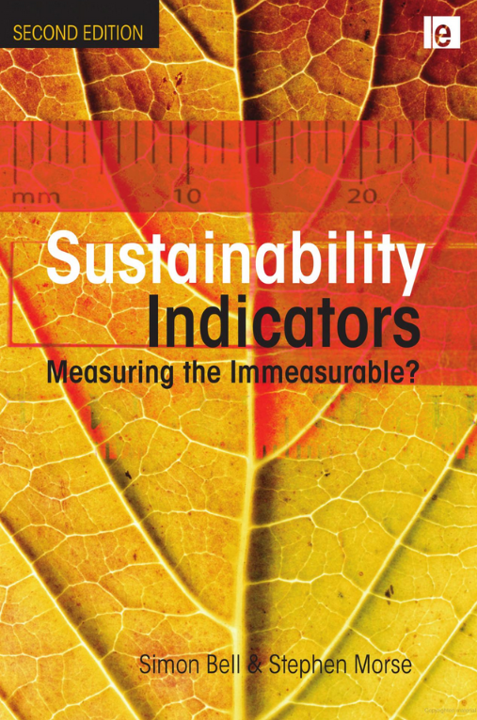

Indicators
…are concise information systems that provide quantitative and qualitative information about the condition and trajectory of a system and why certain trends occur in specified context
Bell, S., Morse, S. (2008). Sustainability Indicators: Measuring the Immeasurable? London, UK: Earthscan
Policy-related purposes:
  Clarifying goals
  Describing trends
  Analyzing conditions
  Projecting developments
  Inventing, evaluating, and selecting alternatives, so long as they are concise and easy to interpret
Clark, T. (2002). The policy process: a practical guide for natural resources professionals. Yale University Press.

Slide 5
Good indicators are:
Simple
  Easy to communicate and capturing key trends
Measurable
  Capable of being quantified
Feasible
  Able to be collected
Flexible
  To allow replacing with new available data
Dynamic
  Capturing changes in stocks and flows over time
User-inspired
  Aligning with the goals of its users and co-produced by these users when possible
Latawiec, A. (eds). 2915. Sustainability Indicators. De Gruyter

Slide 6
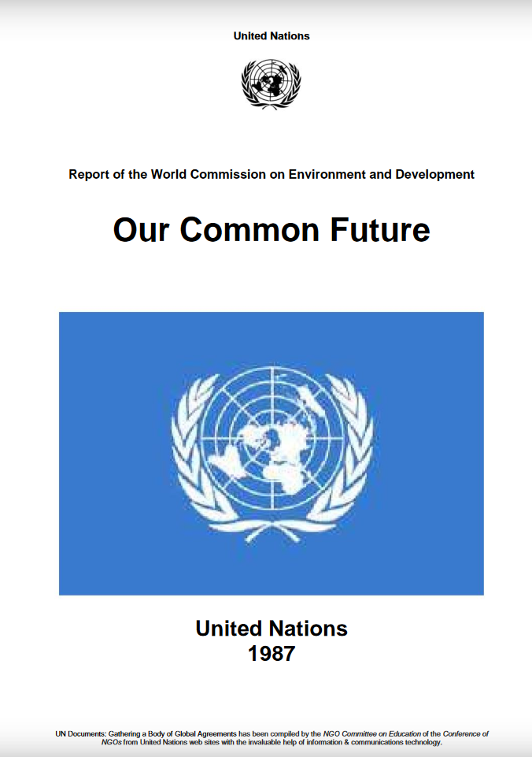
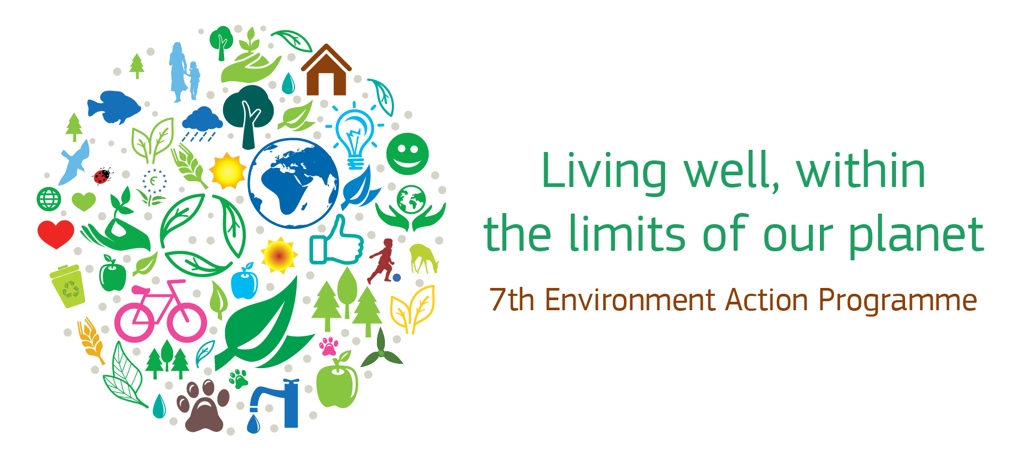
The key challenge:
What is sustainable?
  the concept lucks consensus
  ‘In 2050, we live well, within the planet's ecological limits
  …Our prosperity and healthy environment stem from an innovative, circular economy where nothing is wasted and where natural resources are managed sustainably, and biodiversity is protected, valued and restored in ways that enhance our society's resilience
… not ‘compromising the ability of future generations to meet their own needs’
World Commission on Environment and Development (1987). Our Common Future. Oxford: Oxford University Press.
The 7th EU Environment Action Programme

Slide 7
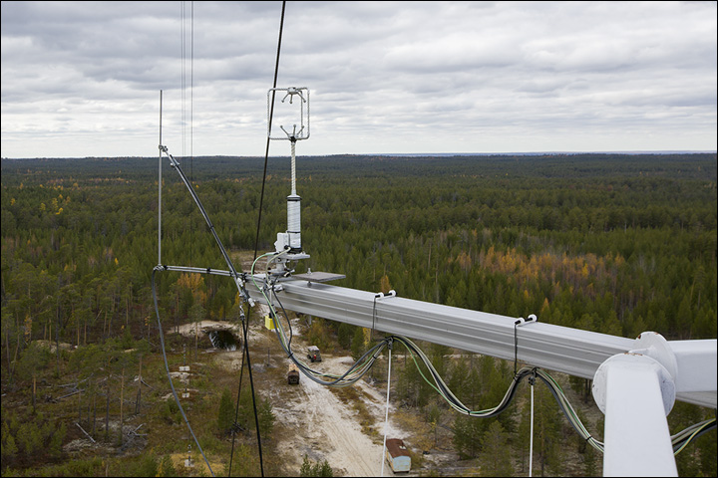
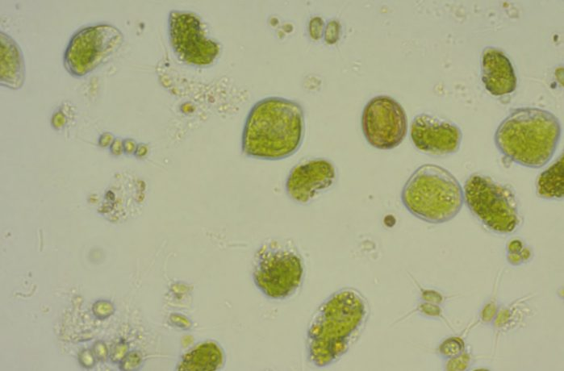
...the planet's ecological limits (1):
Count organisms, species, habitats, biomes (plankton to pixels)
Measure concentrations and fluxes – and estimate stocks

Slide 8
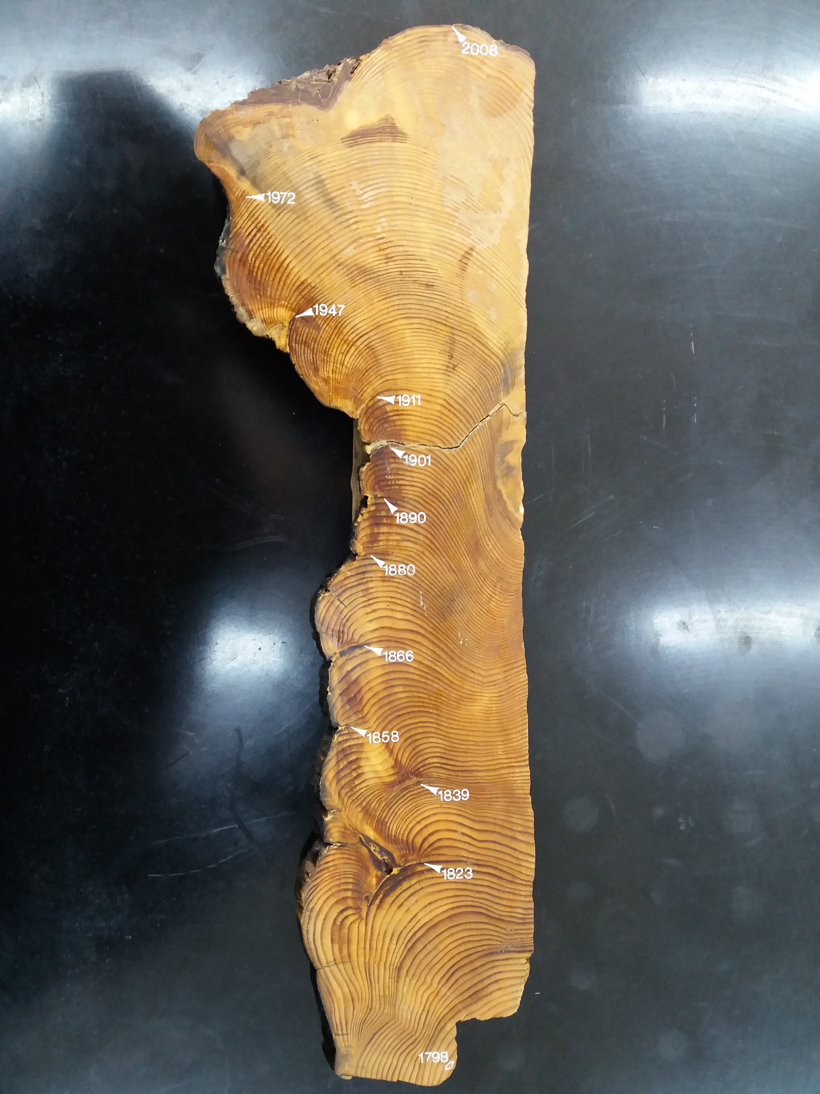
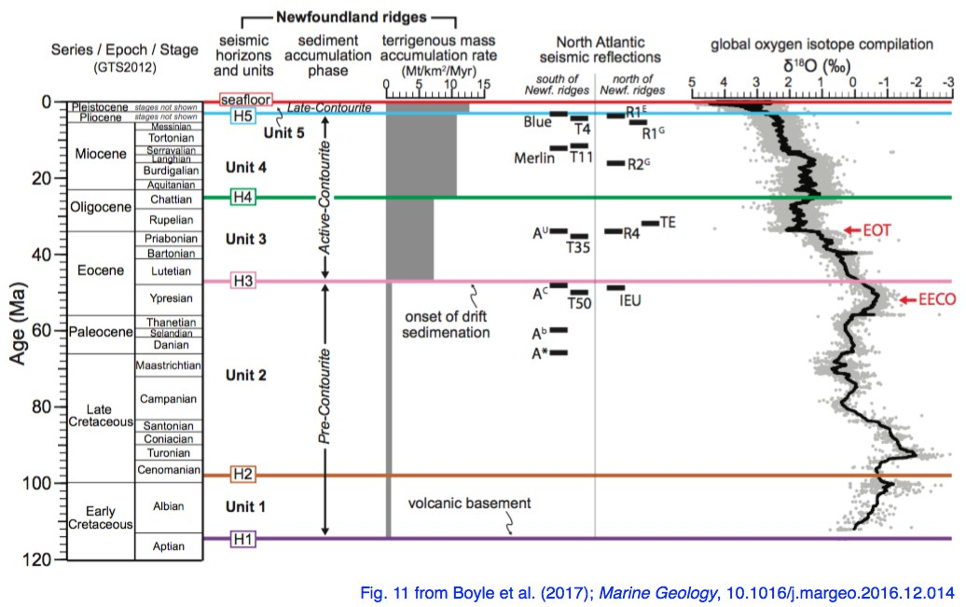
...the planet's ecological limits (2):
Quantify dynamic behaviour – models + observation + theory
Use proxies – indirect measures based on known relationships
Boyle, P., et al, 2017. Cenozoic North Atlantic deep circulation history recorded in contourite drifts, offshore Newfoundland, Canada . Marine Geology, vol. 385, pp. 185-203

Slide 9
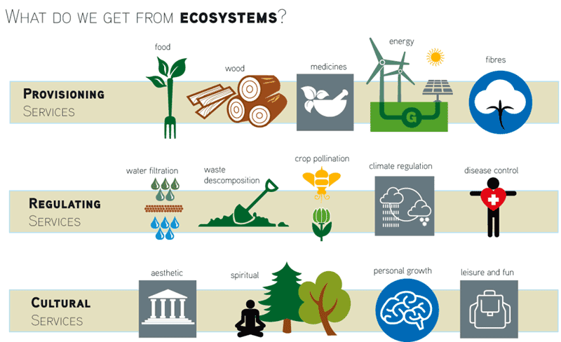
...the planet's ecological limits (3):
value-laden perspectives, e.g. assessment of ‘ecosystem services’
“ecosystem disservices”:
  … functions and properties of ecosystems delivering discomfort to citizens (Döhren & Haase 2015; Lyytimäki 2014)
http://www.ehu.eus

Slide 10
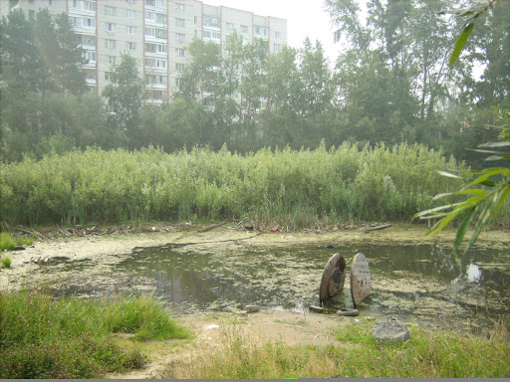
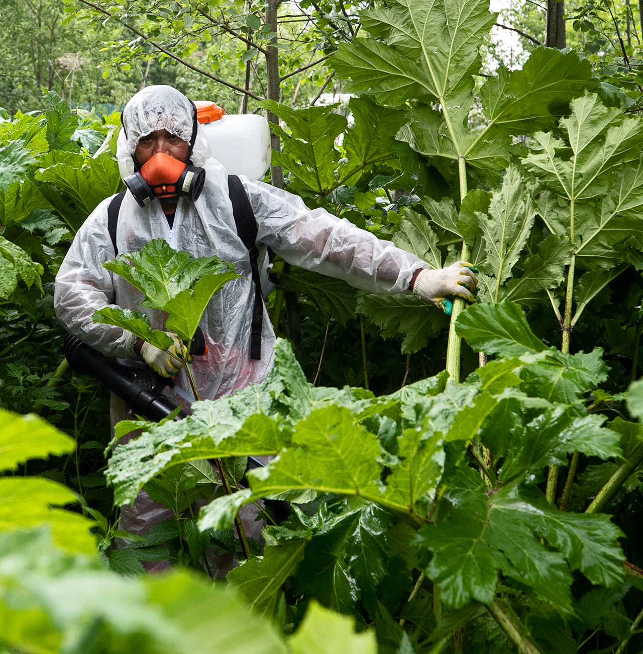
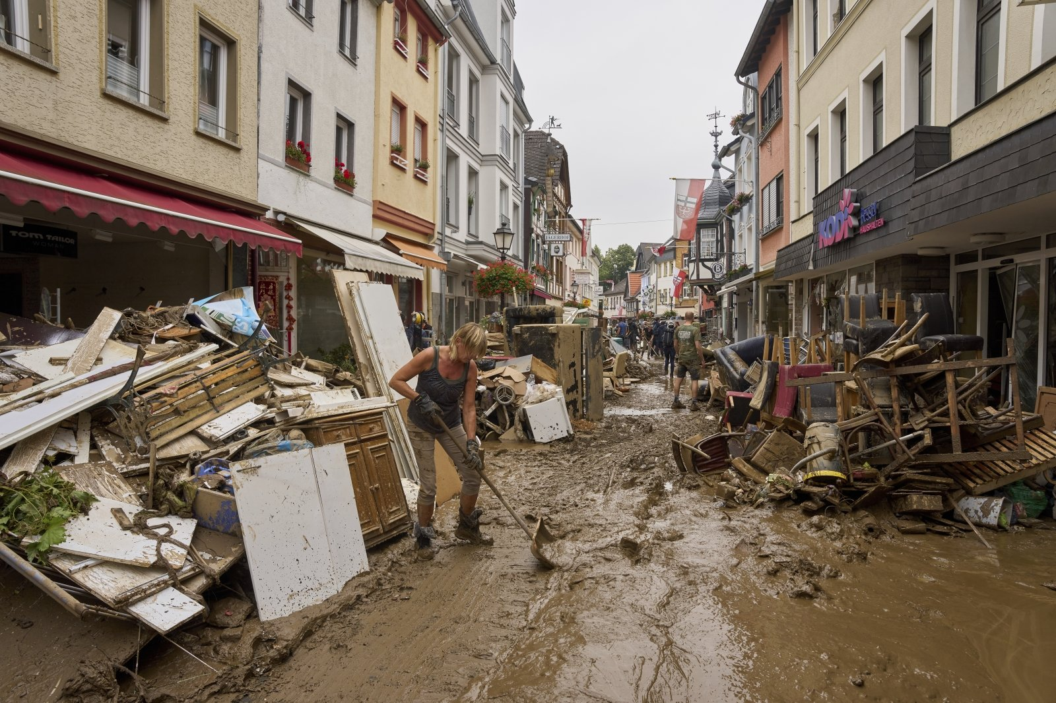
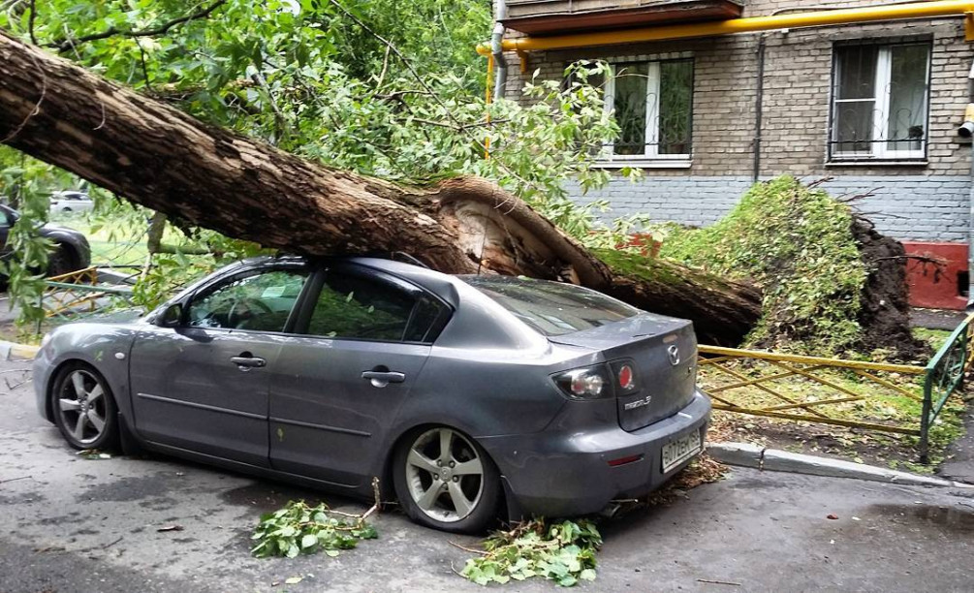
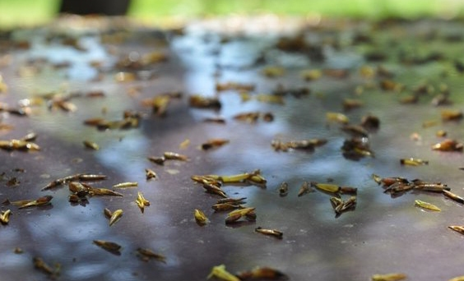
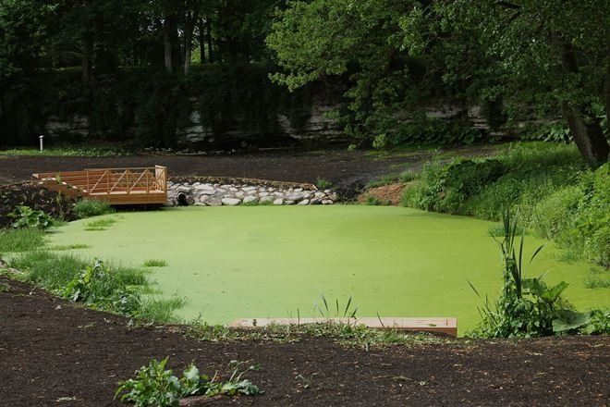
Examples of disservices: ecosystem attributes and functions
Unacceptable ecosystem - bog
Invasive species - hogweed
Flood
Falling old trees and branches
Seeds and pollen causing stain and dirt
Algae bloom

Slide 11

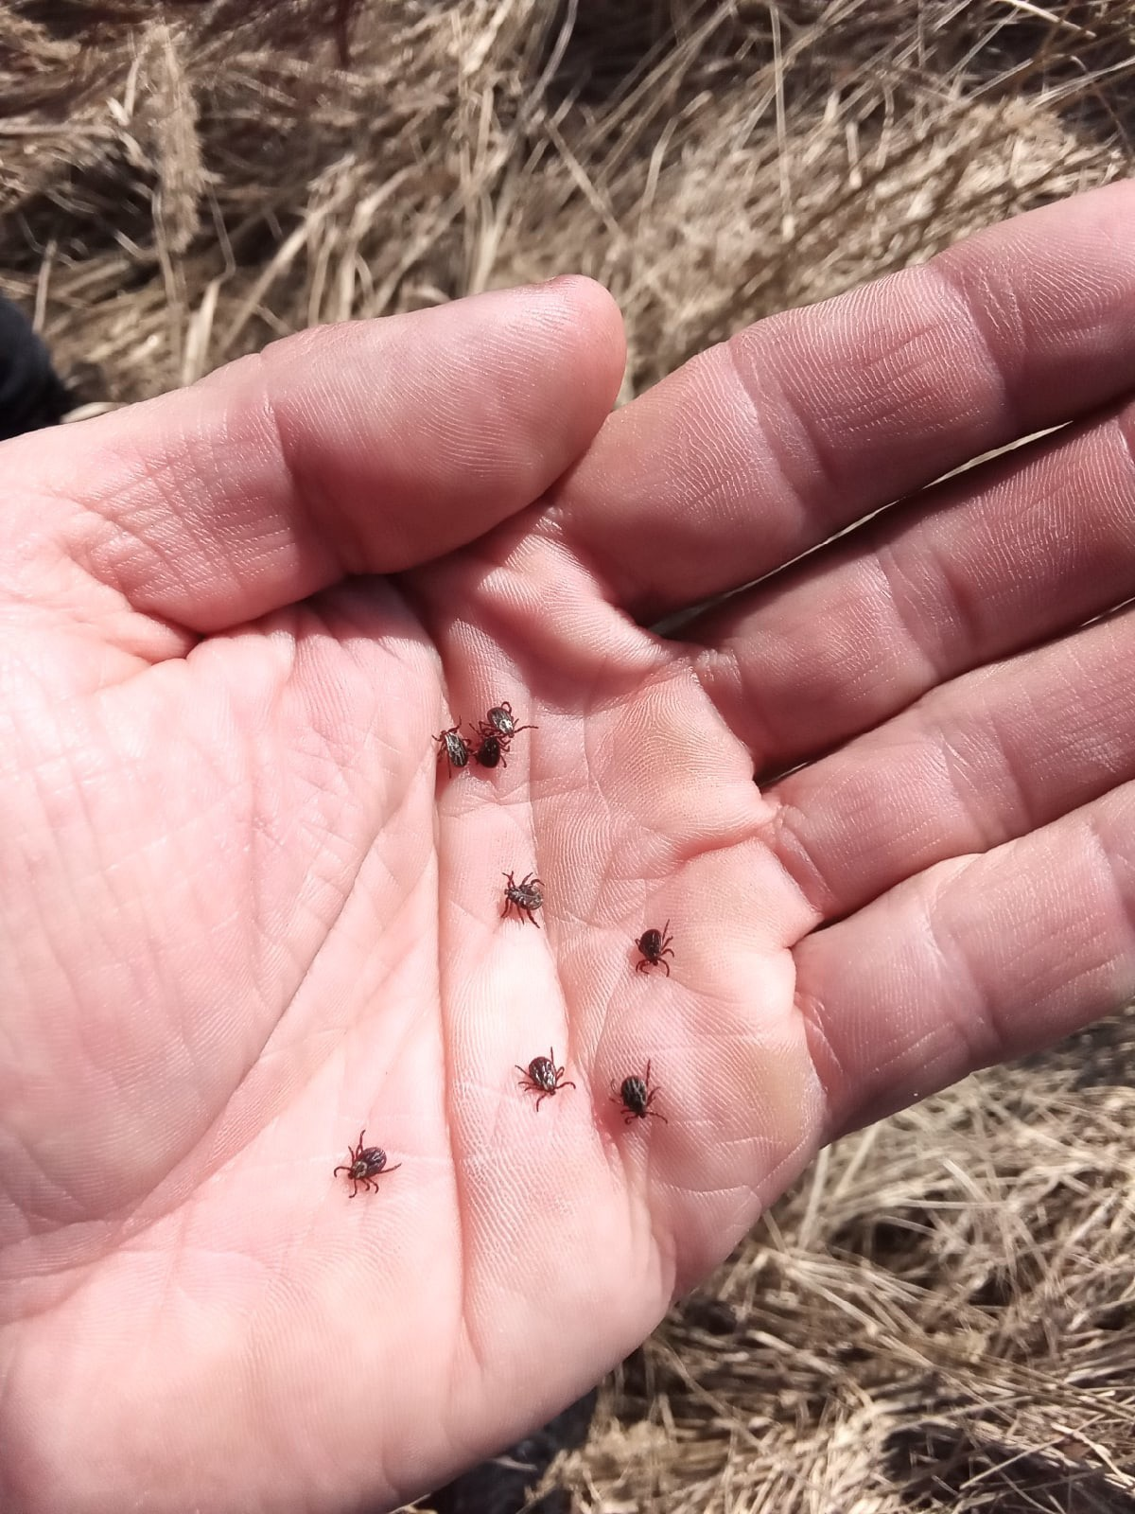
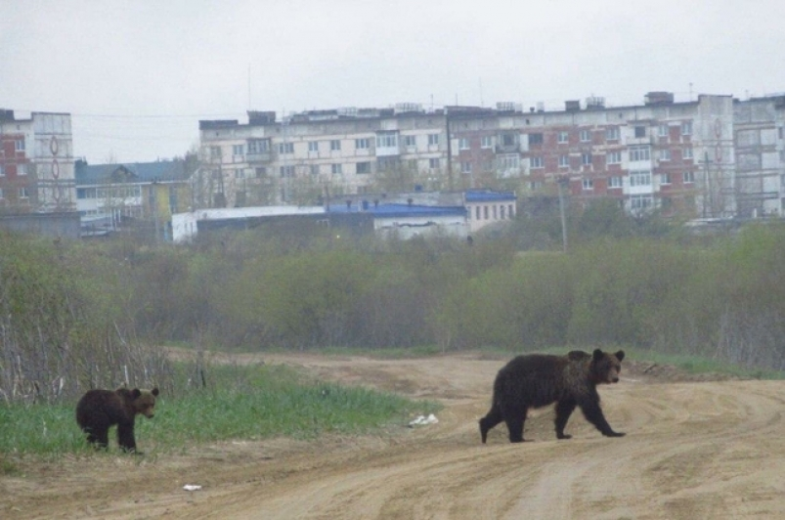
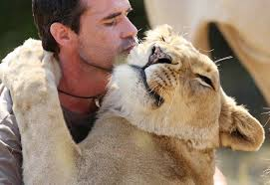
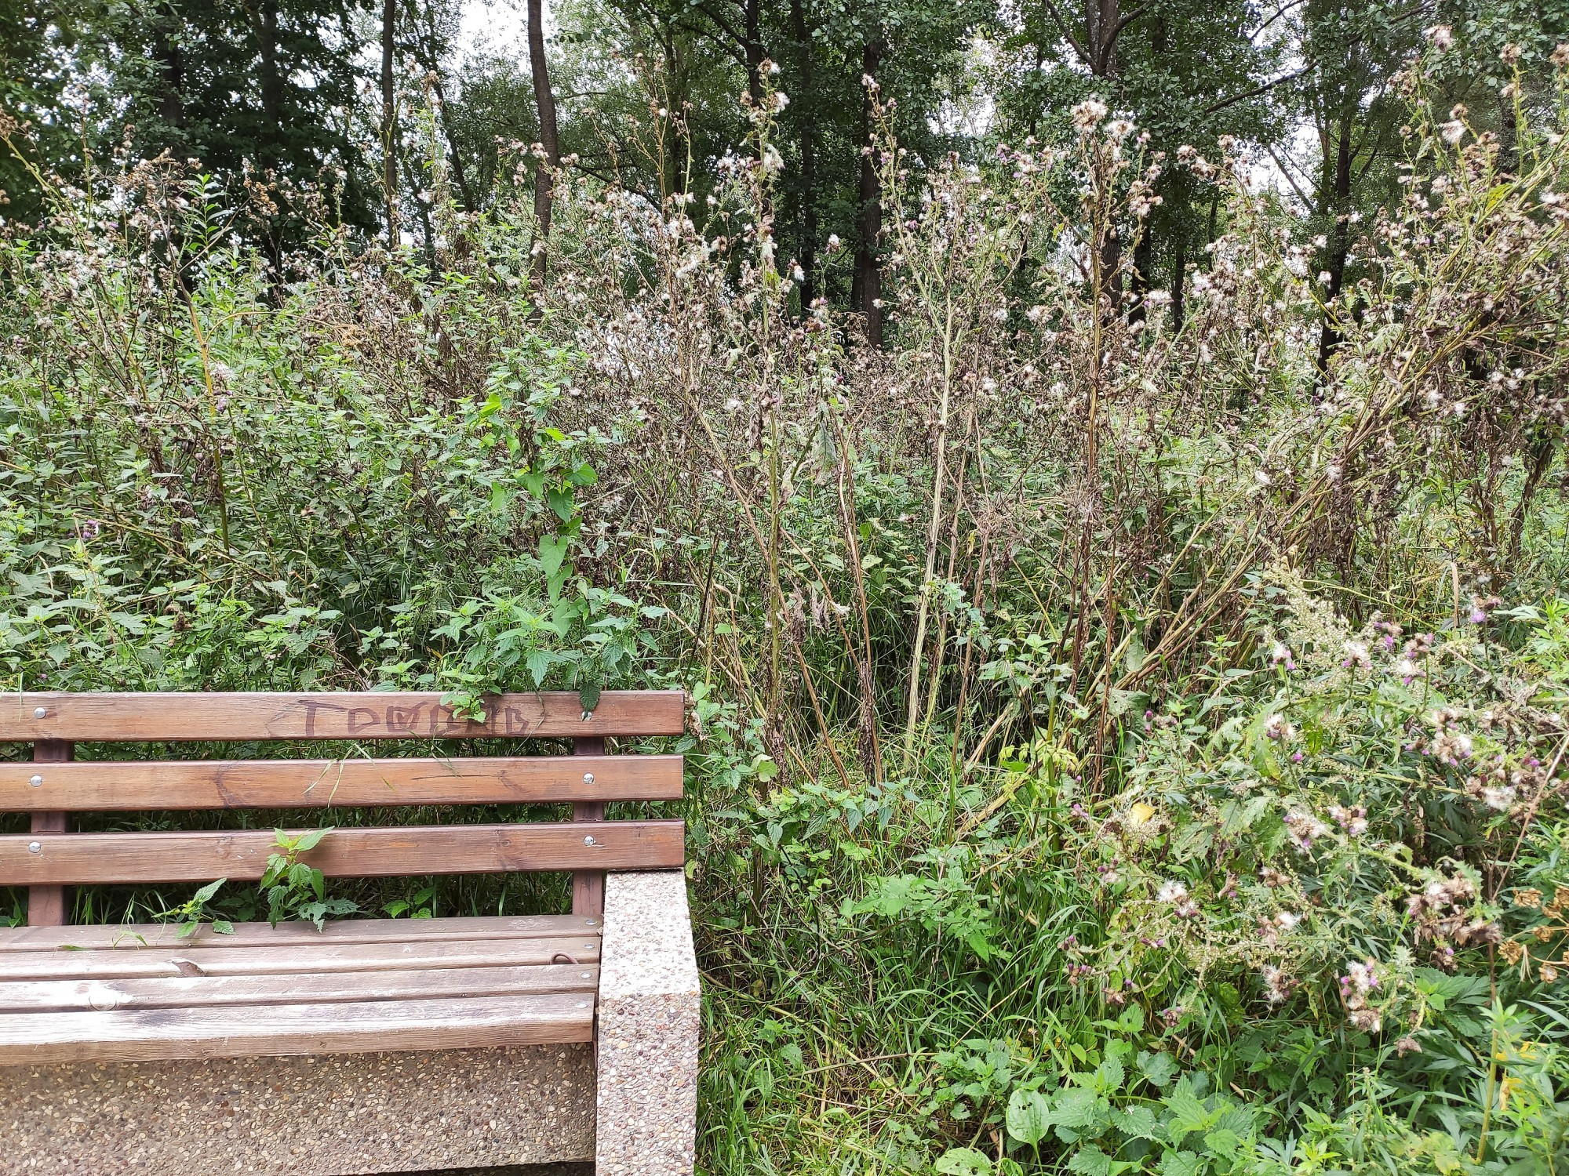
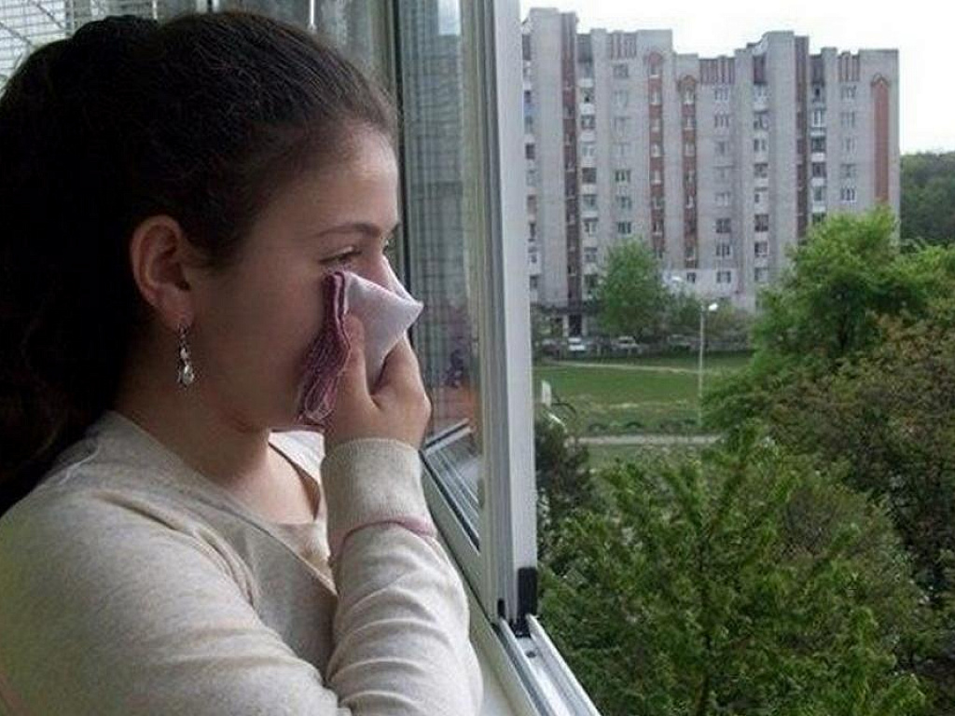
Examples of disservices: human health and aesthetic issues
Allergies
Tick bites
Attacks by wild animals in reality + fear of such probability
Fear of wild animals
Unmanaged green areas
Unpleasant smell

Slide 12
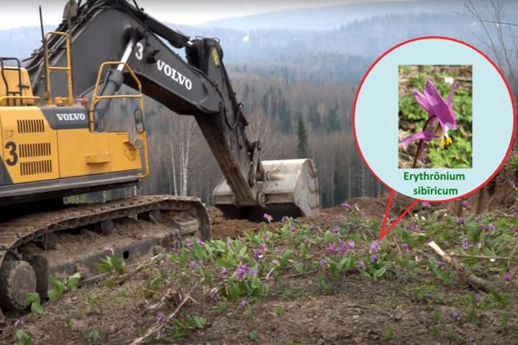
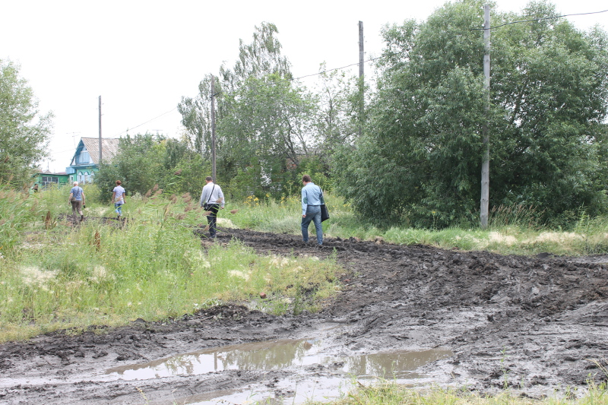
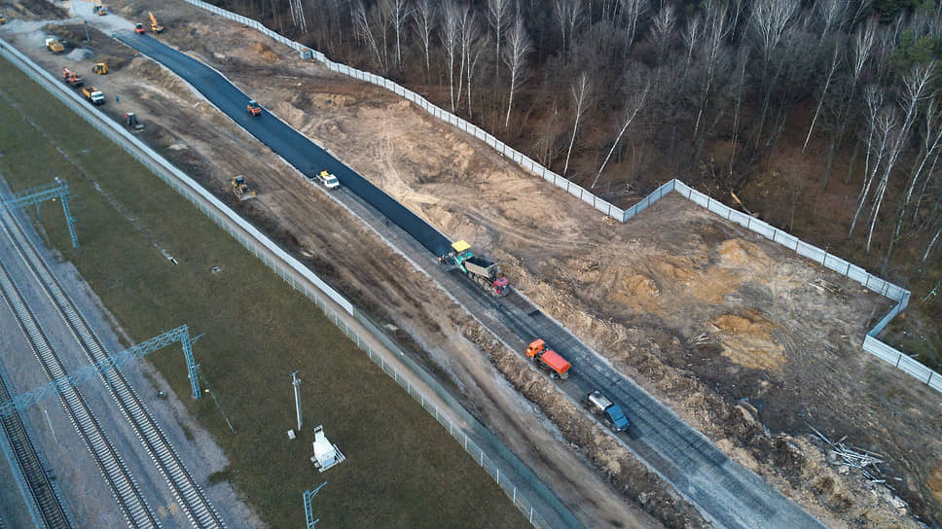
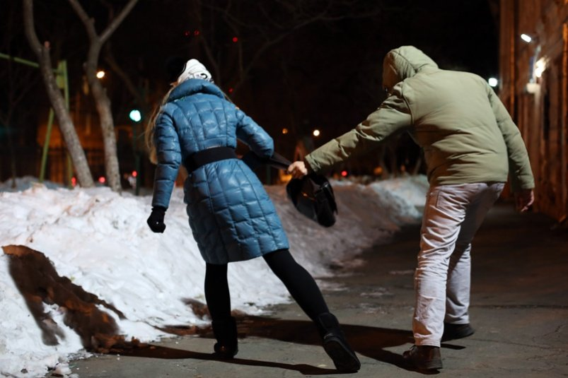

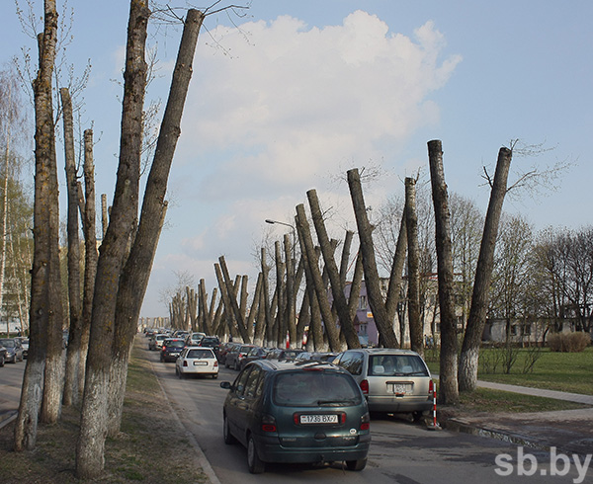
Examples of disservices: restrictions and inhibition of urban planning and development
Protected species and areas inhibit planning and construction
Poor condition of unpaved pads
Protected areas block of transport connectivity
Crimes connected with urban parks
Shade from vegetation
Visual obstacles from vegetation

Slide 13
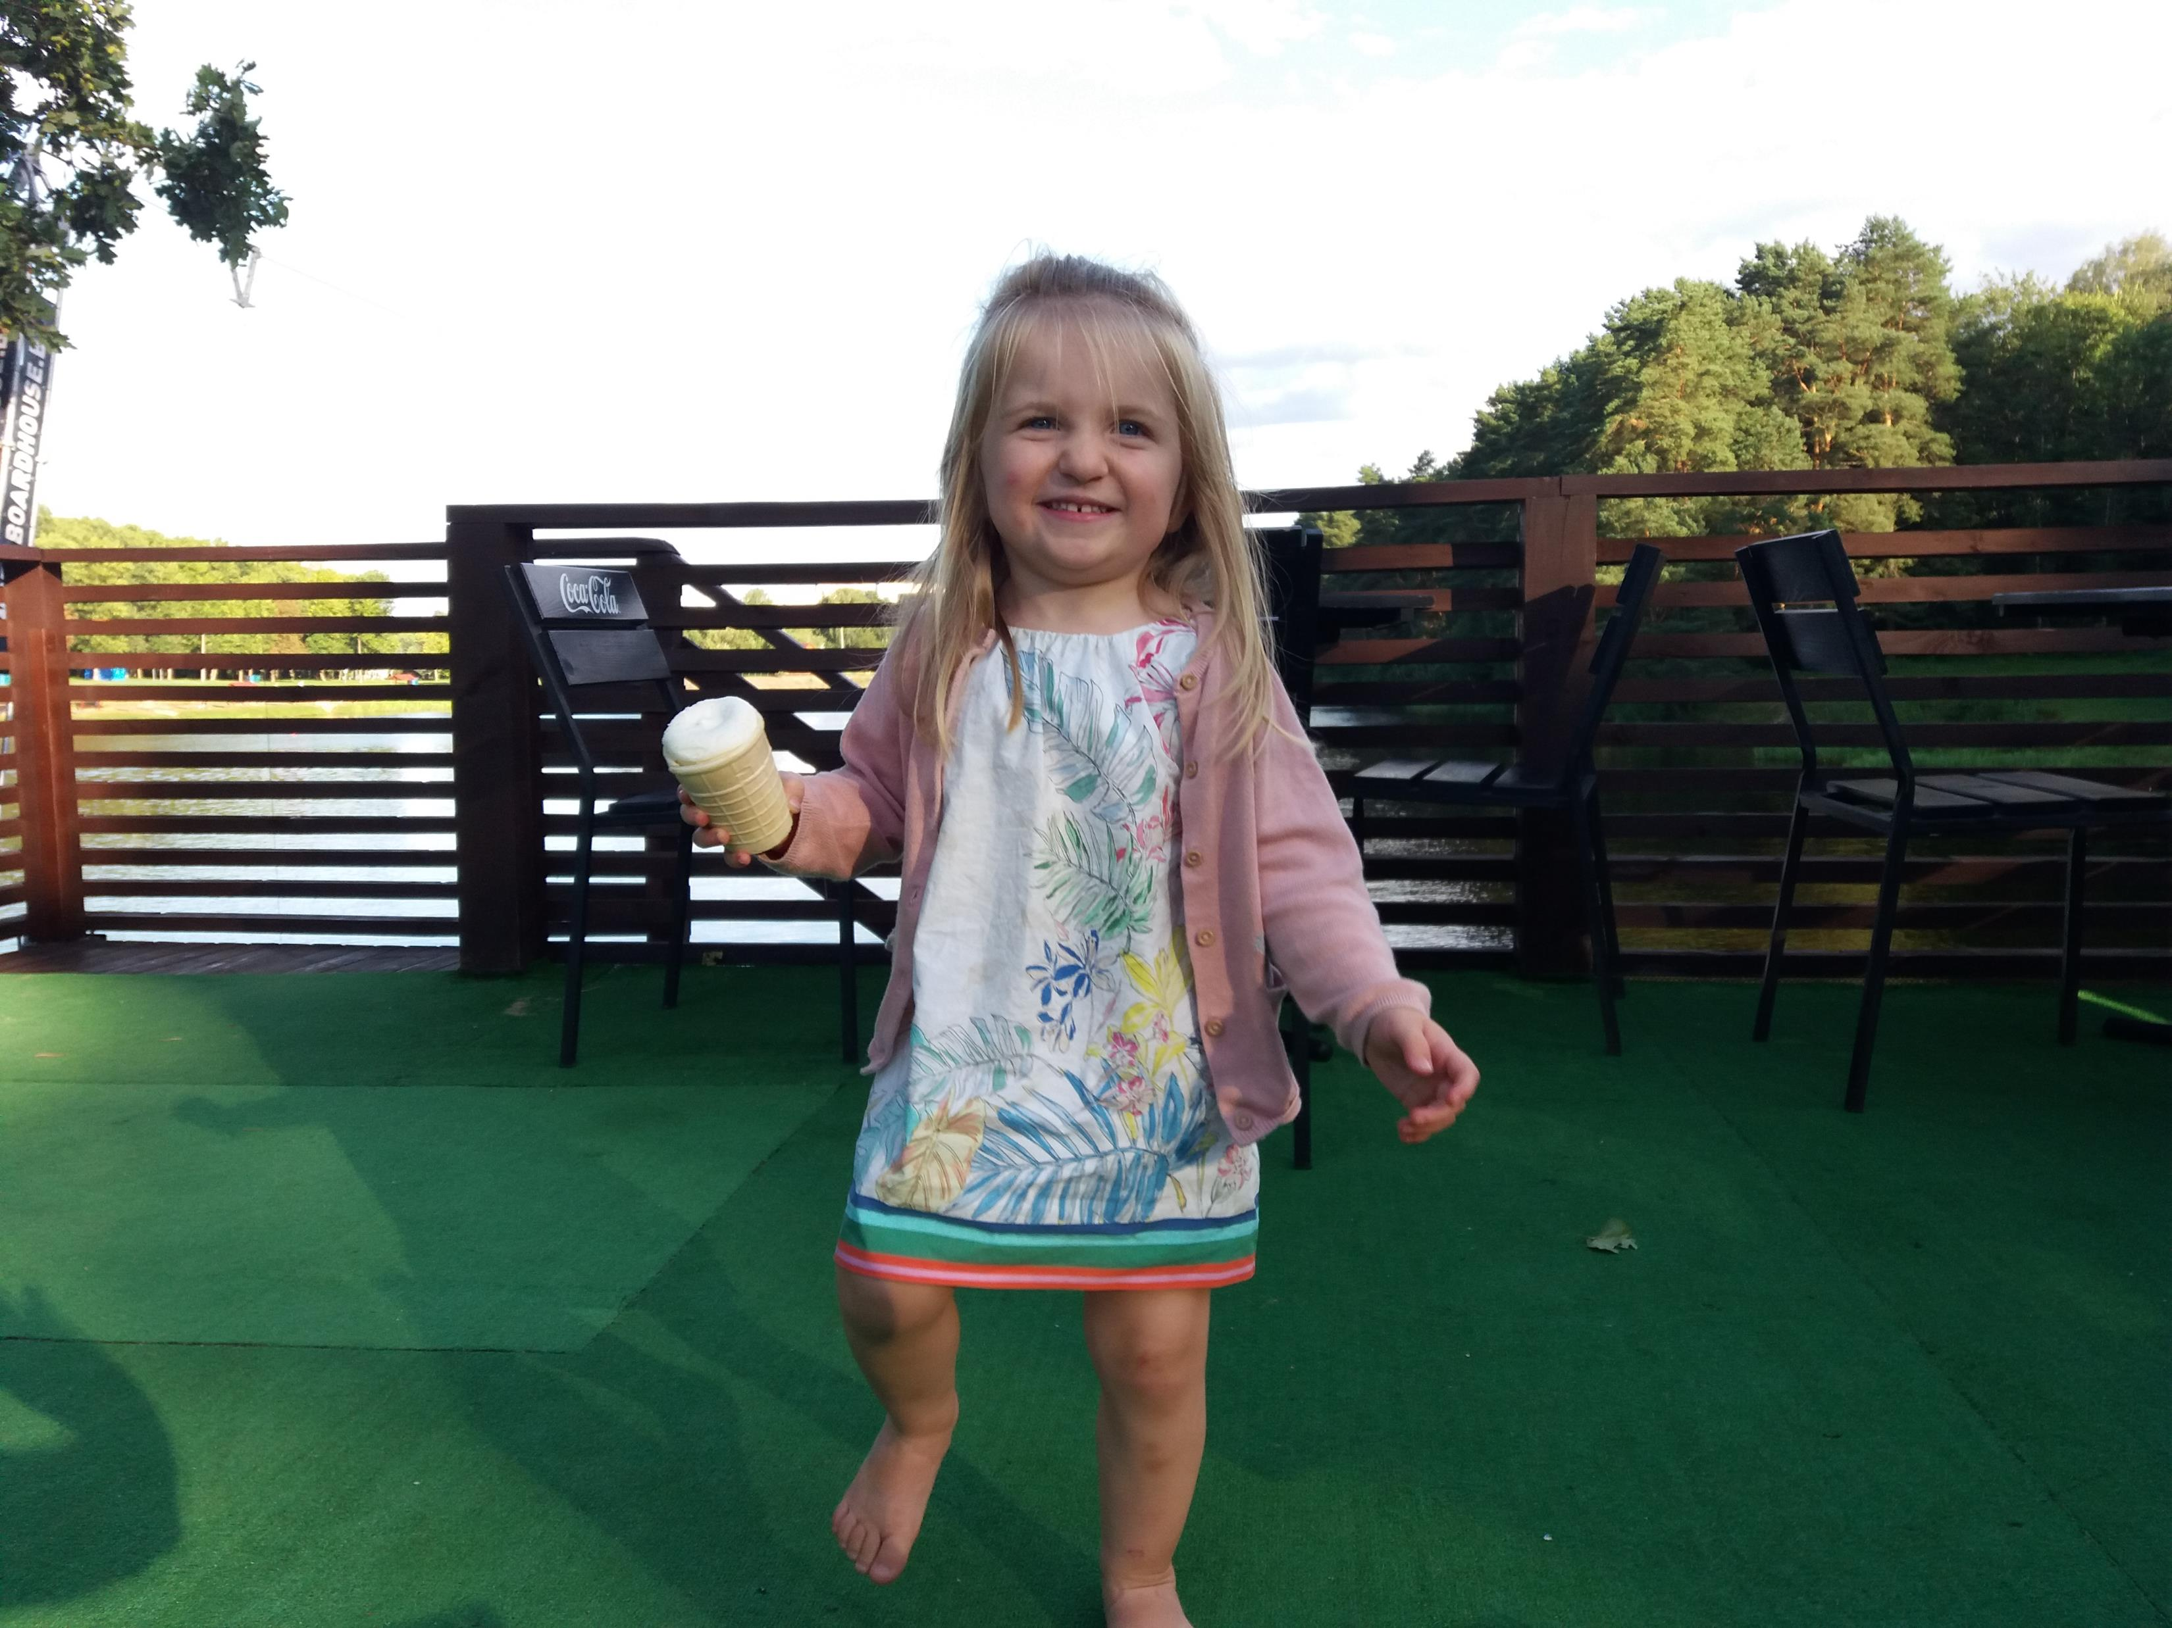
To live well… (1):
The concept of wellbeing encompasses individuals’ capacity to achieve happiness, harmony, identity, fulfillment, self-respect, self-realization, community, transcendence, and enlightenment (Meadows, 1998)

Slide 14
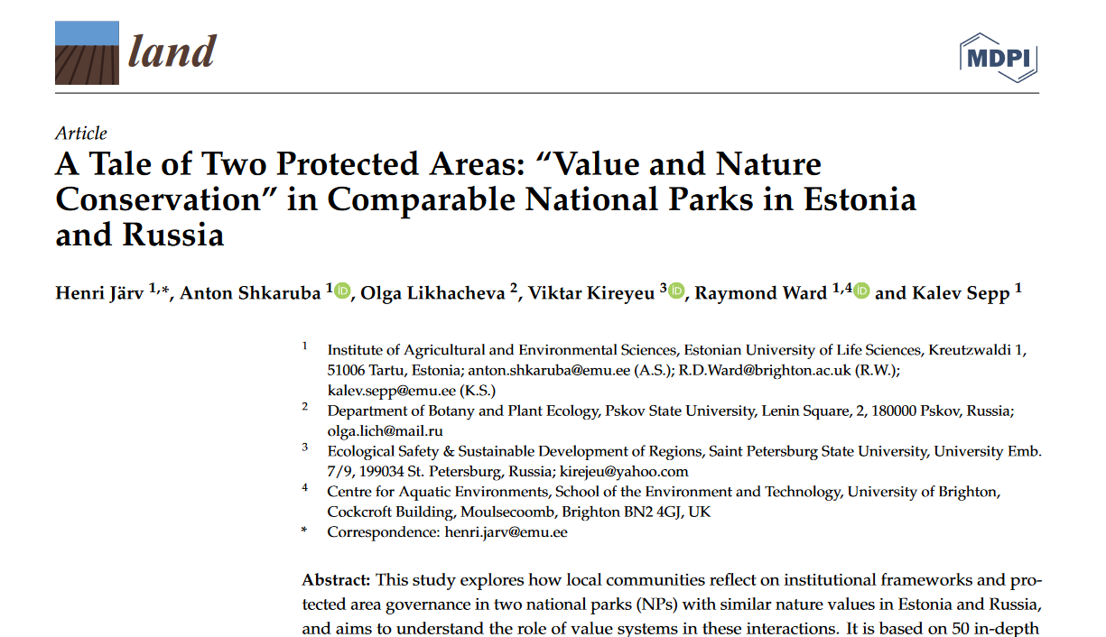
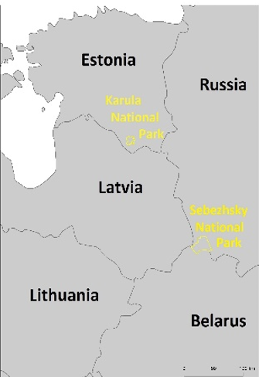
To live well… (3):
Better experience of searching and finding harmony their landscapes => the NP’s mandate to protect cultural landscapes makes space for local communities to be involved, residents have broad access rights, and their lifestyle is related to the management of their landscape
Poor opportunities for relational values to develop => the top-down and rigidly framed approach to conservation, limited flexibility as regards recognition and securing land and forest property rights, and the absence of cultural landscapes in the list of eligible management targets

Slide 15
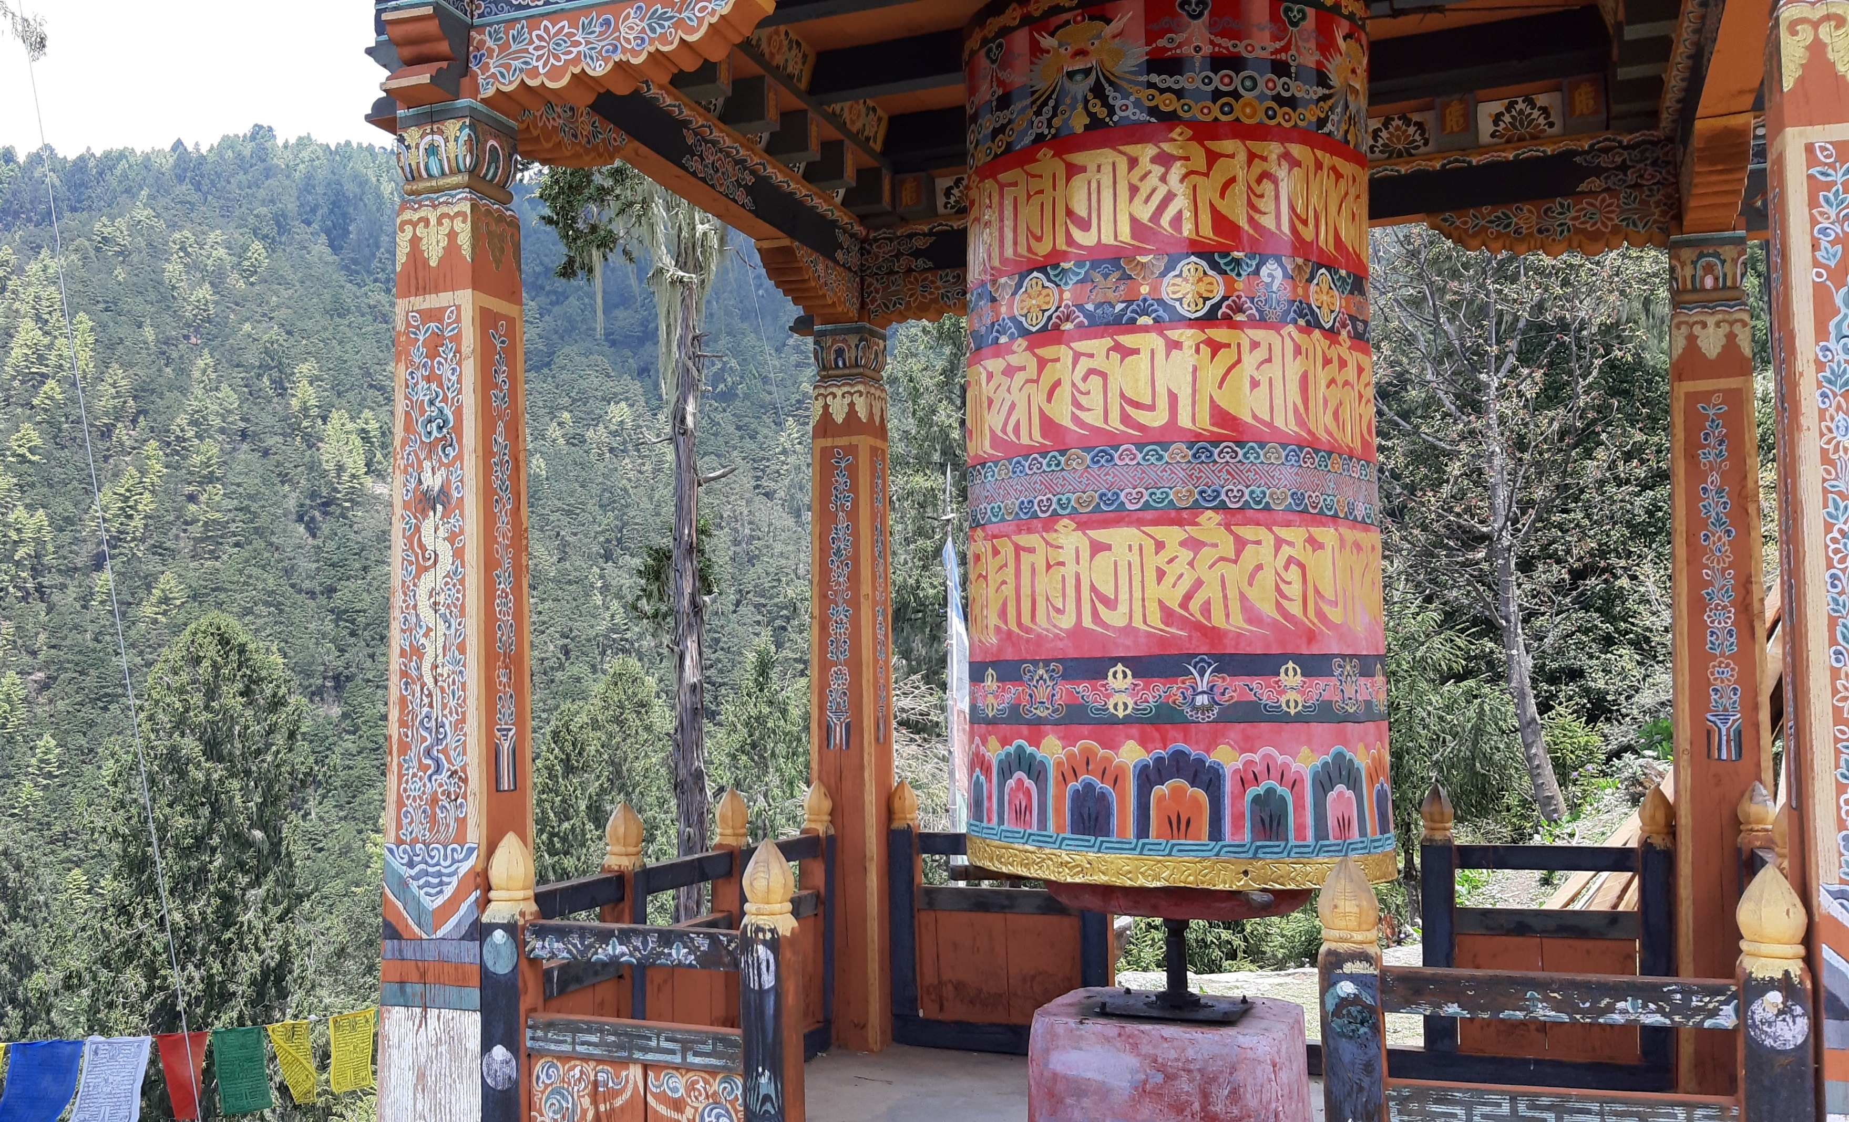
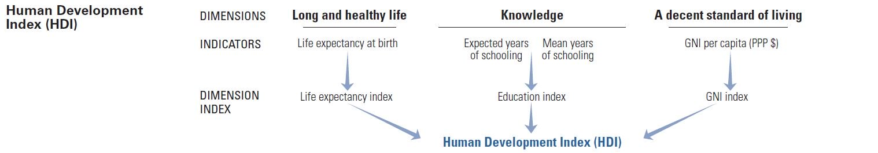
To live well… (4):
Per capita income…
GDP…
Gini coefficient…
Availability of public services, amenities, sanination…
… … … …
Human Development Index
Gross National Happiness
http://hdr.undp.org/en/content/human-development-index-hdi

Slide 16
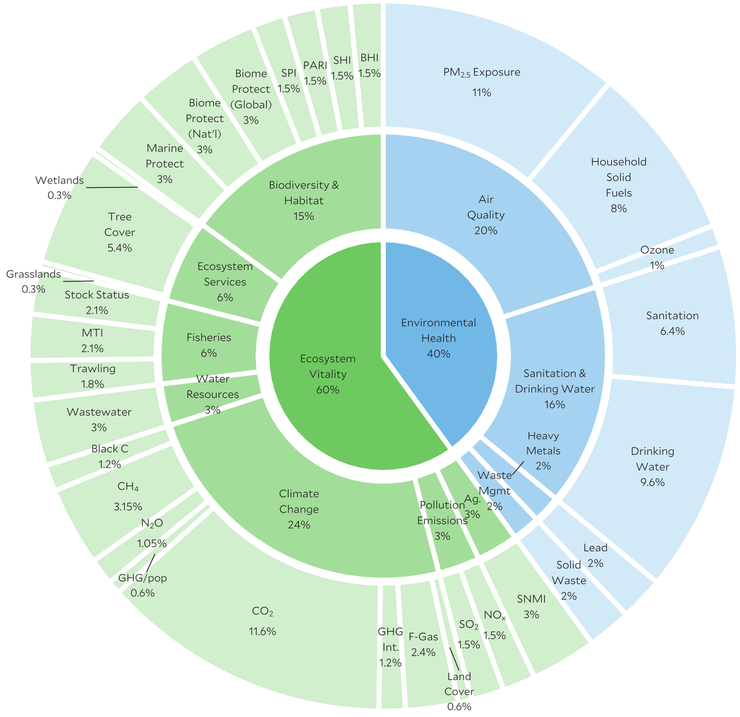
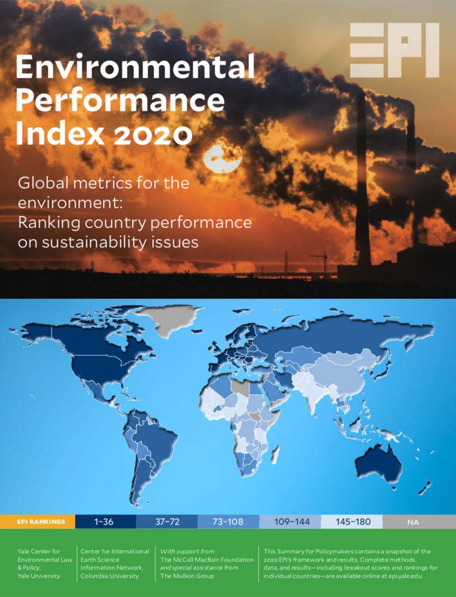
Integration:
Experts interpreting data, e.g. Environmental Performance Index (EPI) by Yale Center for Environmental Law and Policy
2020 EPI Framework: https://epi.yale.edu/

Slide 17

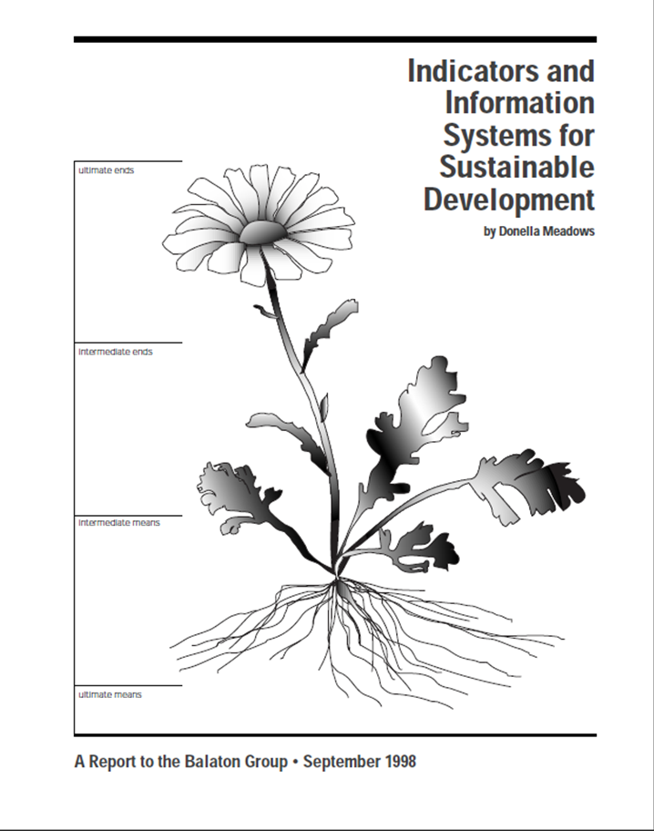
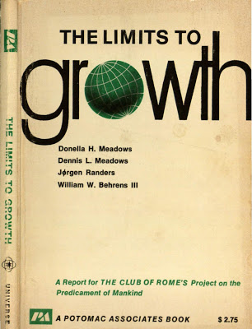
Indicators through participatory process:
…The indicators a society chooses to report to itself about itself are surprisingly powerful. They reflect collective values and inform collective decisions. A nation that keeps a watchful eye on its salmon runs or the safety of its streets makes different choices than does a nation that is only paying attention to its GNP. The idea of citizens choosing their own indicators is something new under the sun something intensely democratic.
https://www.facebook.com/DonellaMeadowsProject
Meadows, D.H. (1998). Indicators and information systems for sustainable development.
Sustainability Institute Hartland.

Slide 18
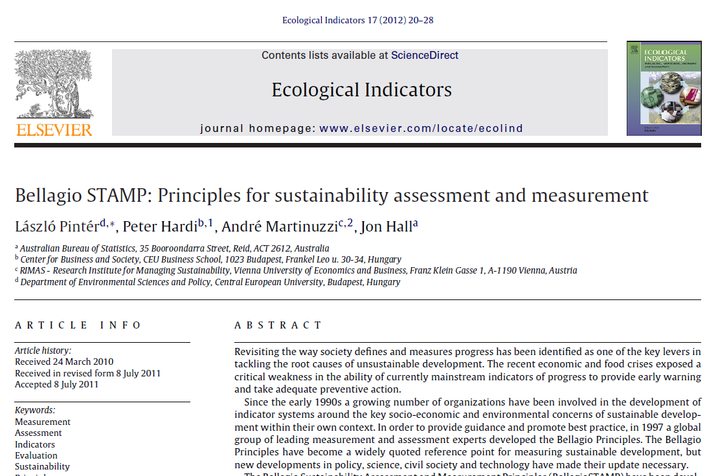
Belagio stamp

Slide 19
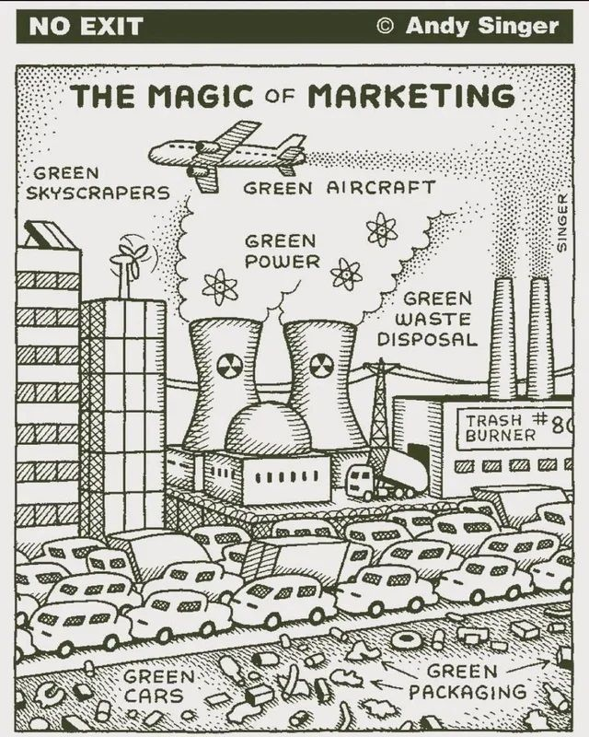
EDS – how to?
Management action (e.g. adding or maintaining infrastructure)
Communication strategy
Awareness rising
Avoid greenwashing!!!

Slide 20
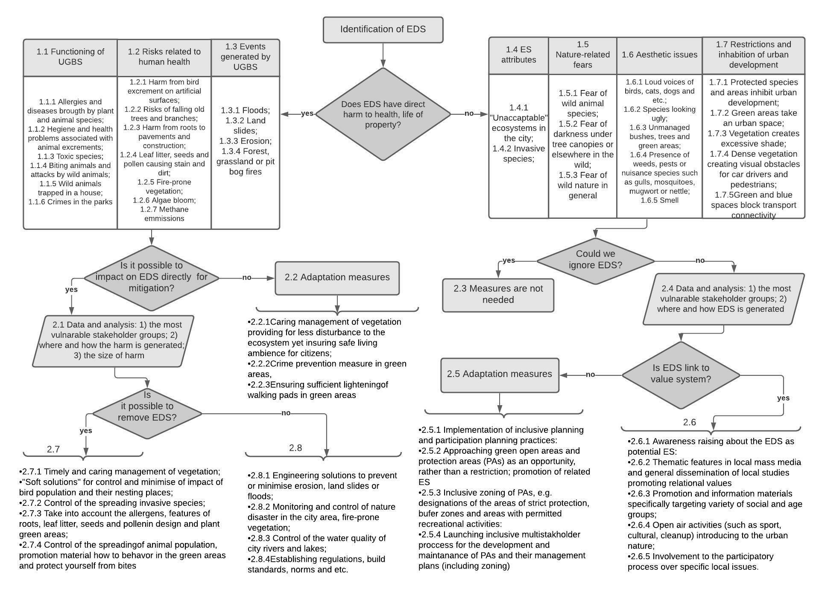
The decision-making tree for the identification and management of EDS in cities

Slide 21
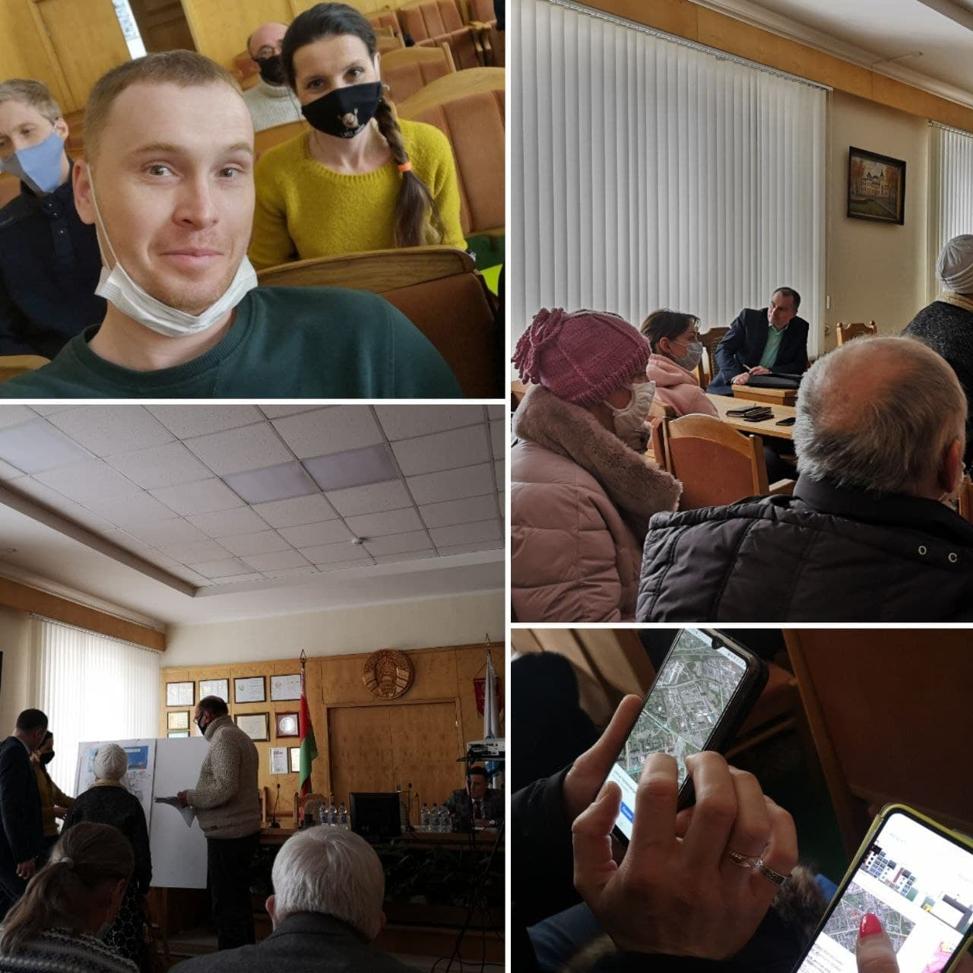
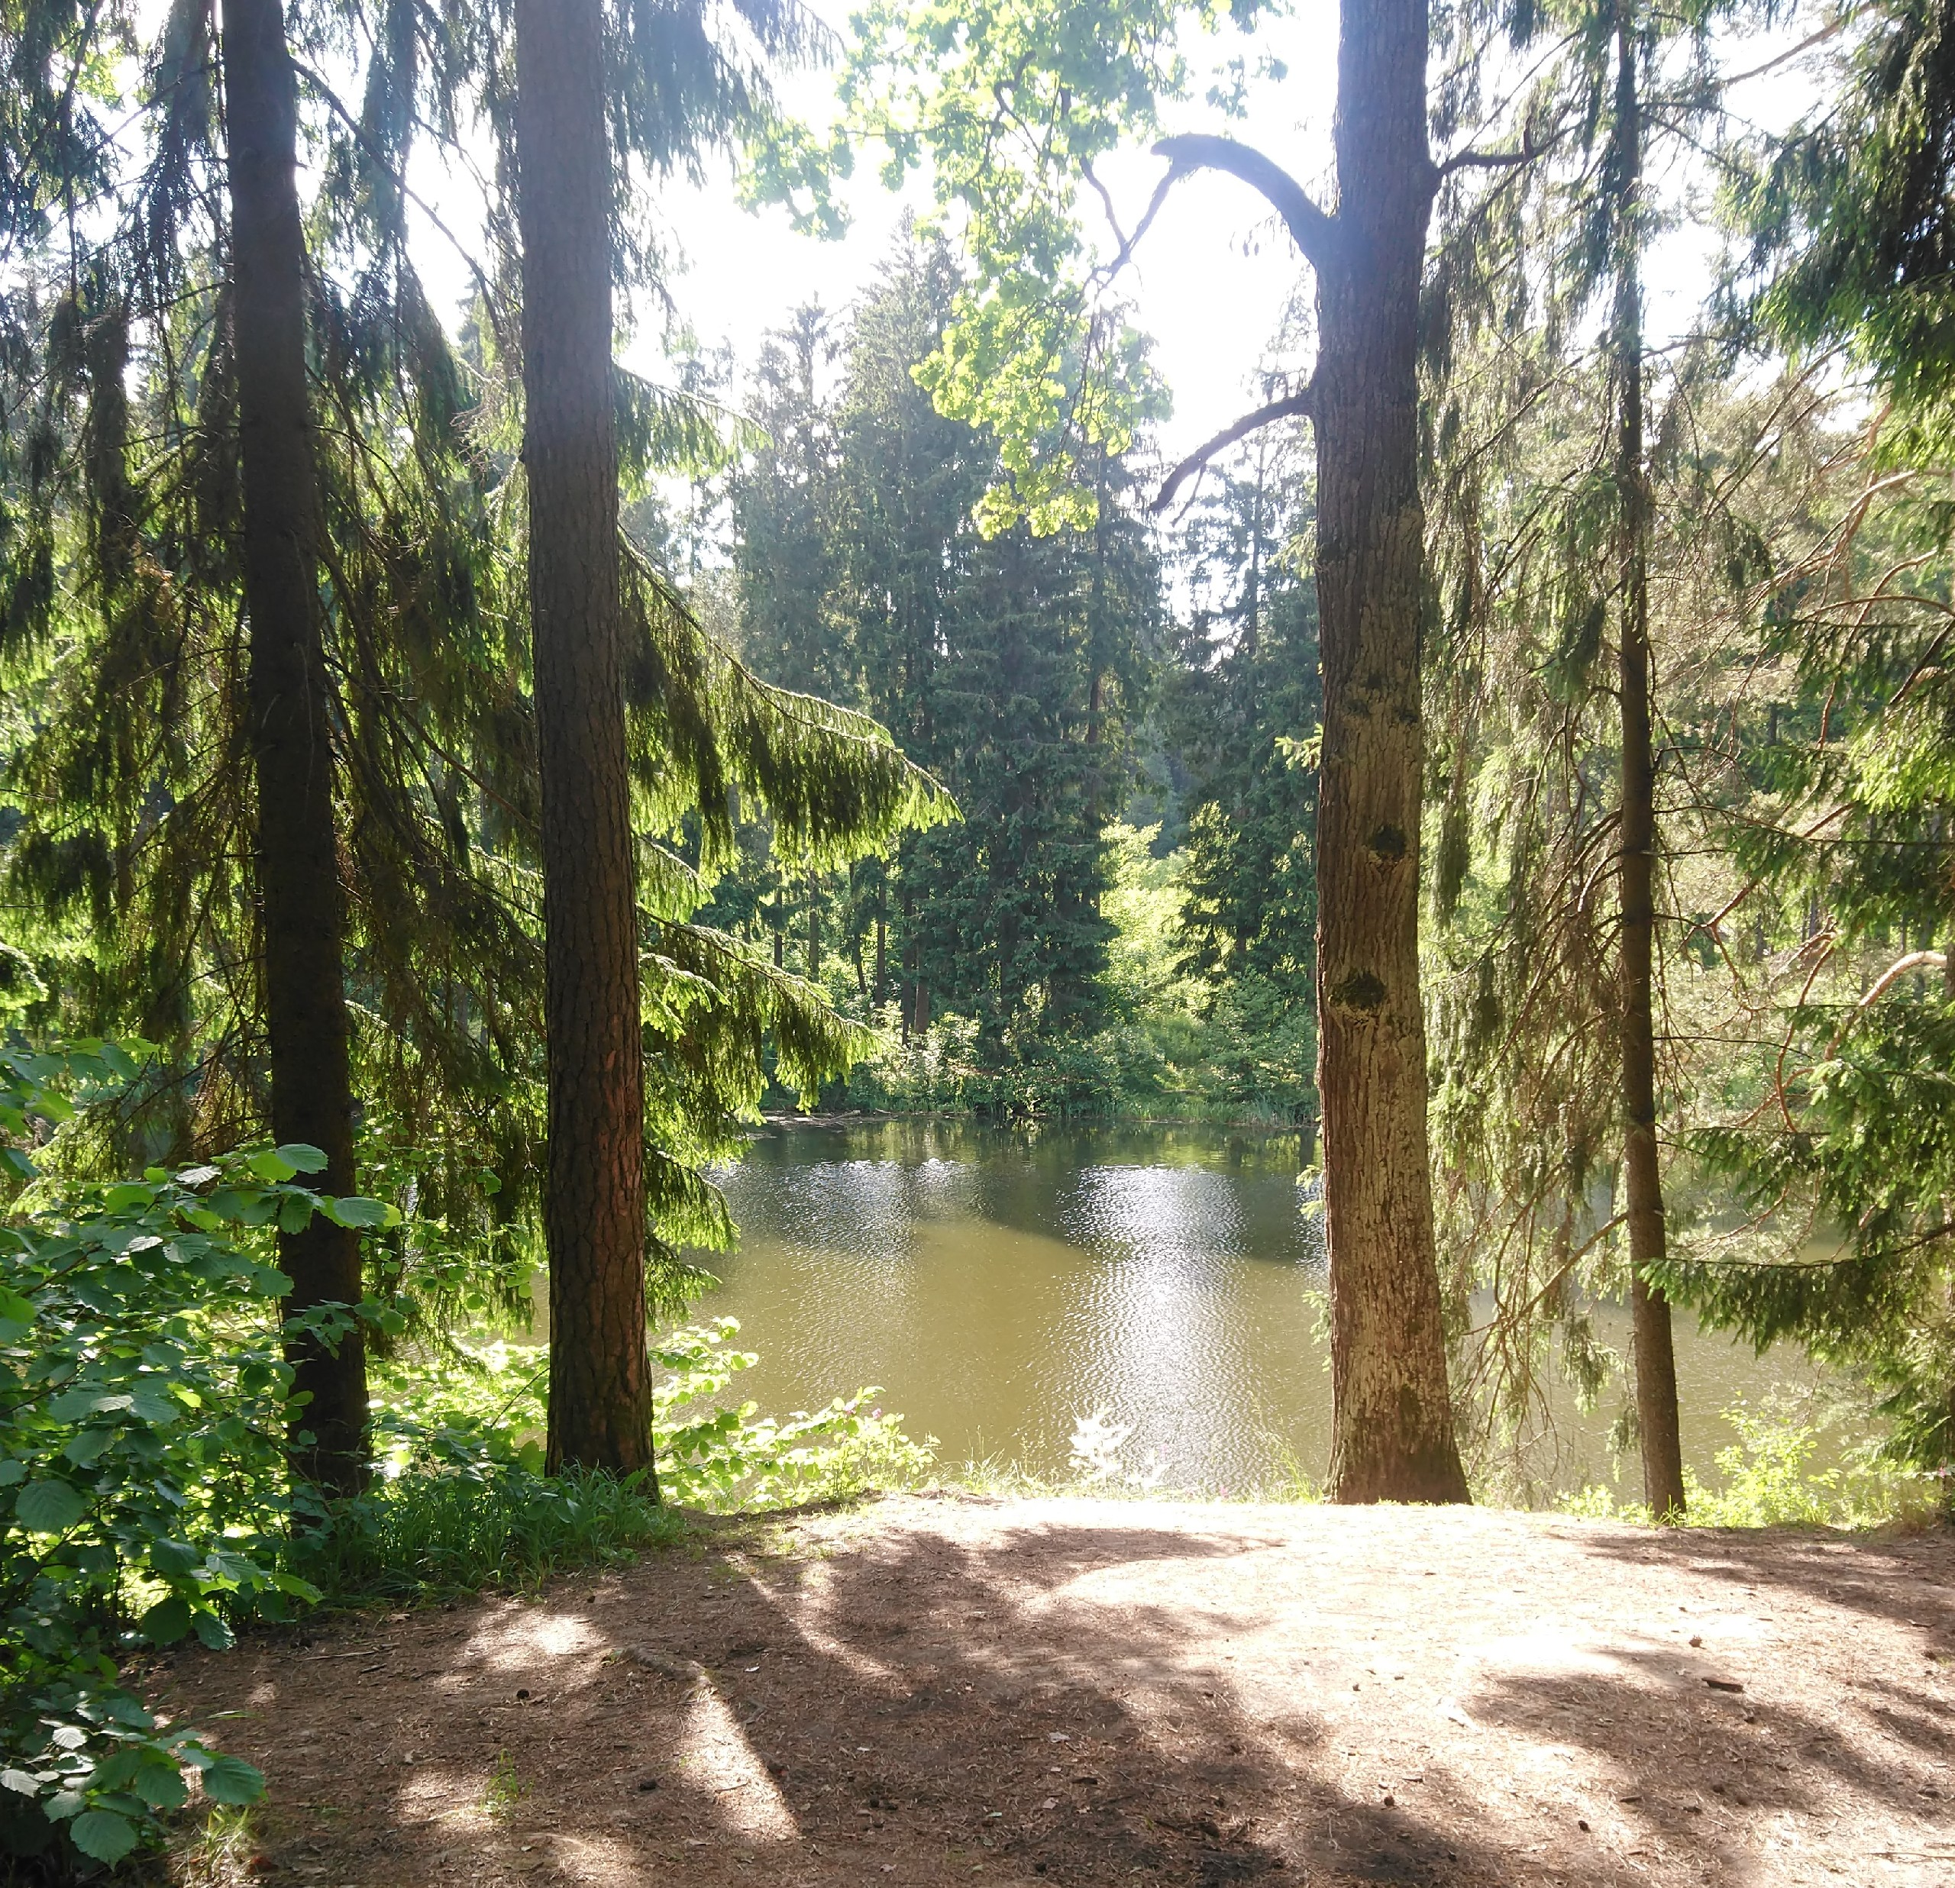
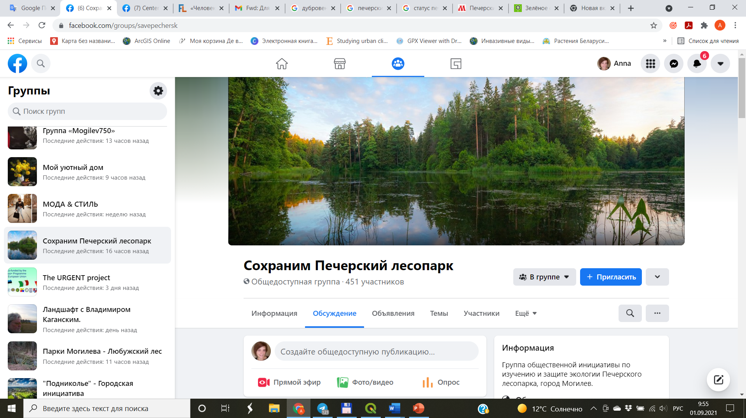
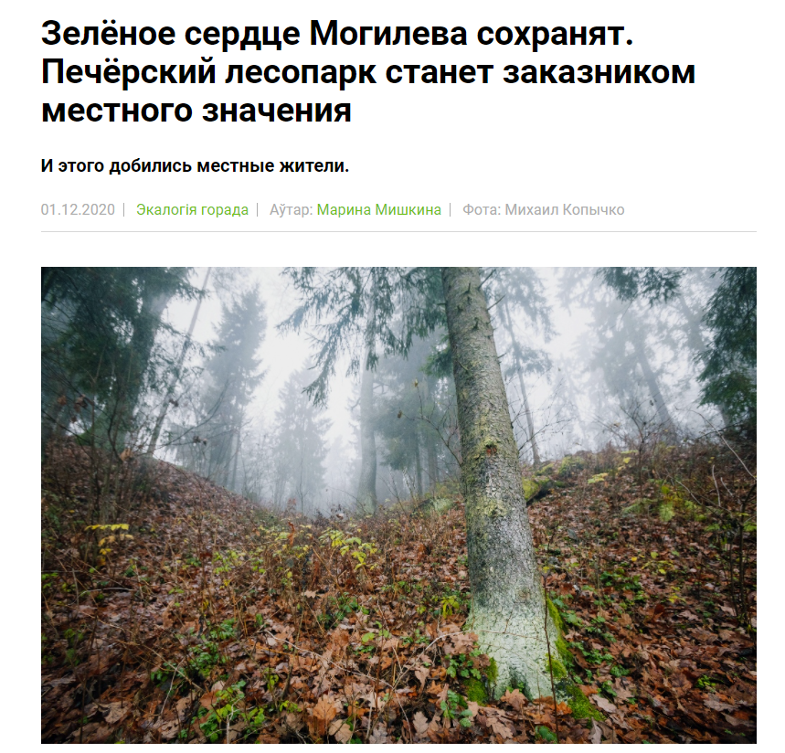
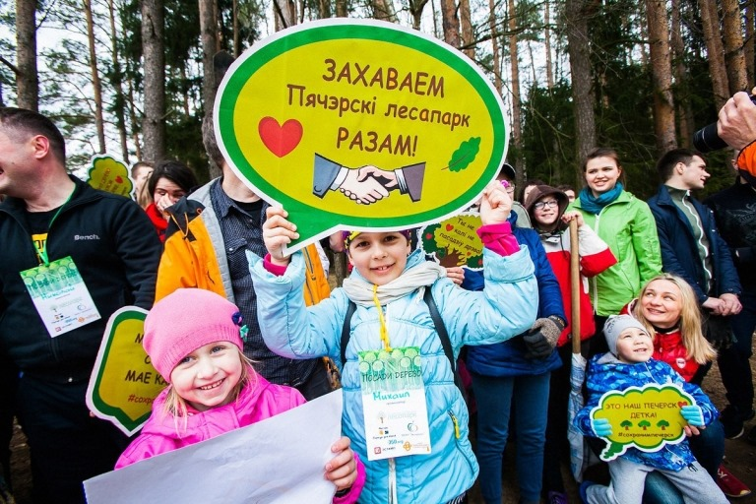
Situation 3: what adaptation of mindsets took place, and what hopes it gives

Slide 22
The problems and challenges of socially oriented research in the field of life sciences
QUESTIONS?
101071314 BETTER Life
Bringing Excellence to Transformative Socially Engaged Research in Life Sciences through Integrated Digital Centers
Anton Shkaruba
anton.shkaruba@emu.ee
September 14, 2023
Ecosystem Services, Tourism, Community Engagement, and Conservation Strategies in National Park, BetterLife summer school, Prague September 9-14, 2024

